Slide 1

Adding Associations
An association is a relationship between types (or more specifically, instances
of those types) that indicates some meaningful and interesting connection
Consider including the following associations in a domain model:
• Associations for which knowledge of the relationship needs to be pre-
served for some duration ("need-to-know" associations).
• Associations derived from the Common Associations List.

Slide 2
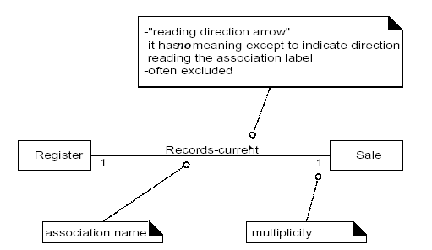
UML Association Notation

Slide 3
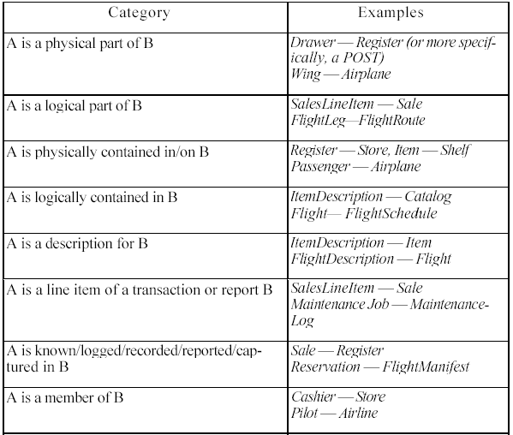
Finding Associations-Common List

Slide 4
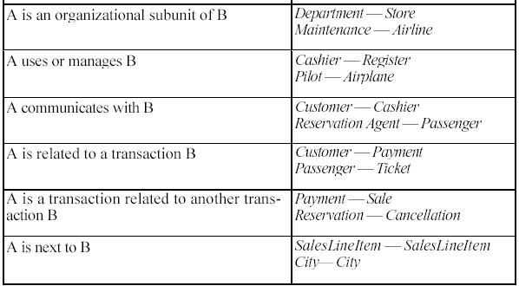
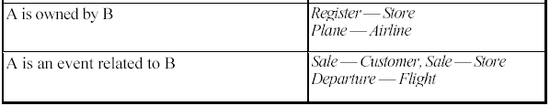
Finding Associations-Common List...

Slide 5
Association Guidelines
Here are some high-priority association categories that are invariably useful to
include in a domain model:
• A is a physical or logical part of B.
• A is physically or logically contained in/on B.
• A is recorded in B.
• Focus on those associations for which knowledge of the relationship needs
to be preserved for some duration ("need-to-know" associations).
• It is more important to identify conceptual classes than to identify
associations.
• Too many associations tend to confuse a domain model rather than illu-
minate it. Their discovery can be time-consuming, with marginal benefit.
• Avoid showing redundant or derivable associations.

Slide 6
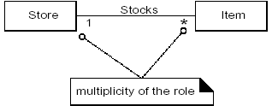
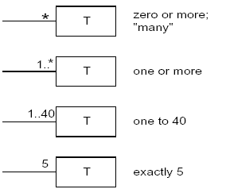
Multiplicity
Multiplicity defines how many instances of a class A can be associated with
one instance of a class B

Slide 7
POS Example
The following sample of associations is justified in terms of a need-to-know. It is
based on the use cases currently under consideration.
Register Records Sale To know the current sale, gener-
ate a total, print a receipt.
Sale Paid-by Payment To know if the sale has been paid,
relate the amount tendered to the
sale total, and print a receipt
ProductCatalog Records
ProductSpecification To retrieve an ProductSpecifica-
given an itemID.
.

Slide 8
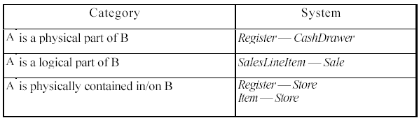
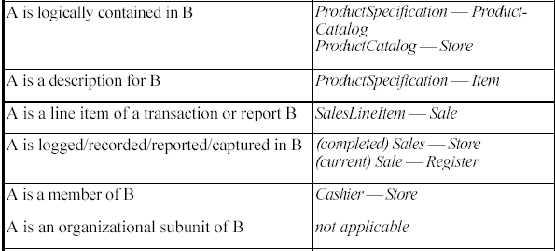
Appliying the Category of Associations

Slide 9
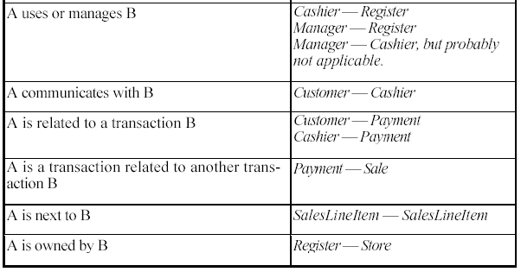
Appliying the Category of Associations...
• Focus on those associations for which knowledge of the relationship needs
to be preserved for some duration ("need-to-know" associations).
• Avoid showing redundant or derivable associations.

Slide 10
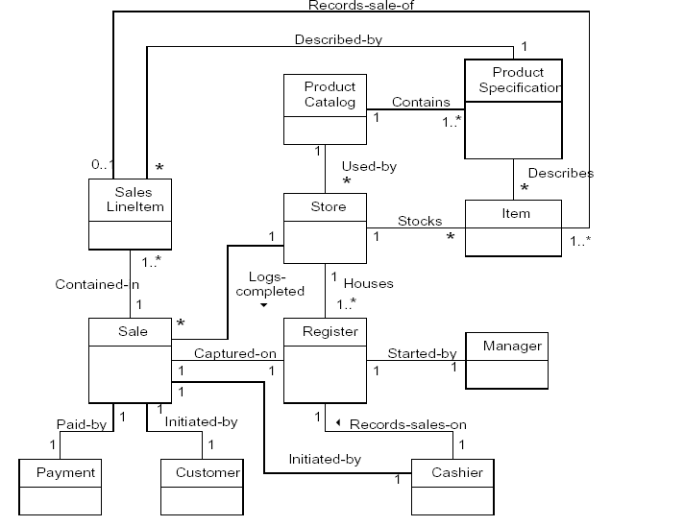
A Partial Domain Model

Slide 11

Adding Attributes
An attribute is a logical data value of an object.
Include the following attributes in a domain model: Those for which the
requirements (for example, use cases) suggest or imply a need to
remember information.

Slide 12
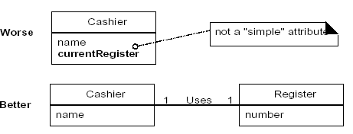
Valid Attribute Types
The attributes in a domain model should preferably be simple attributes or
data types.
Very common attribute data types include: Boolean, Date, Number, String
(Text), Time
Other common types include: Address, Color, Geometries (Point, Rectangle),
Phone Number, Social Security Number, Universal Product Code (UPC), SKU,
ZIP or postal codes, enumerated types

Slide 13
Valid Attribute Types...
Represent what may initially be considered a primitive data type (such as a
number or string) as a non-primitive class if:
• It is composed of separate sections.
o phone number, name of person
• There are operations usually associated with it, such as parsing or valida-
tion.
o social security number
• It has other attributes.
o promotional price could have a start (effective) date and end
date
• It is a quantity with a unit.
o payment amount has a unit of currency
• It is an abstraction of one or more types with some of these qualities.
o item identifier in the sales domain is a generalization of types
such as Universal Product Code (UPC) or European Article
Number (EAN)

Slide 14
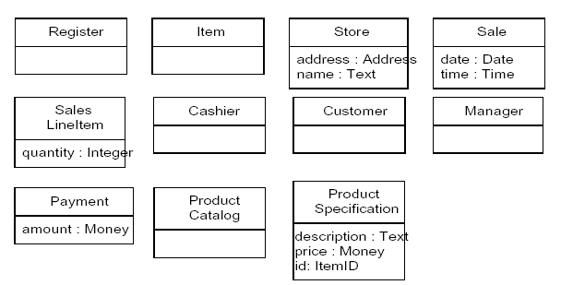
Attributes in the NexGen Domain Model

Slide 15
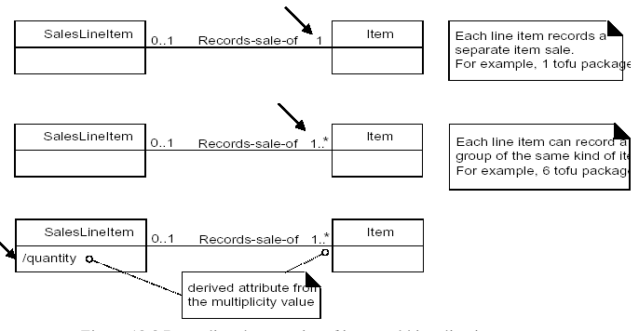
Multiplicity From SaleLineItem to Item

Slide 16
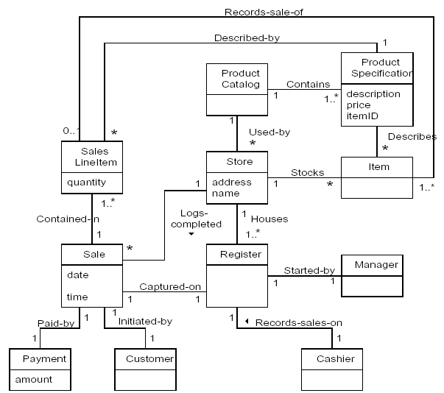
Domain Model of NexGen

Slide 17

From Requriments to Design
During object design, a logical solution based on the object-oriented paradigm is
developed. The heart of this solution is the creation of interaction diagrams,
which illustrate how objects collaborate to fulfill the requirements.
After.or in parallel with.drawing interaction diagrams, (design) class dia-
grams can be drawn. These summarize the definition of the software classes
(and interfaces) that are to be implemented in software.
In terms of the UP, these artifacts are part of the Design Model.

Slide 18
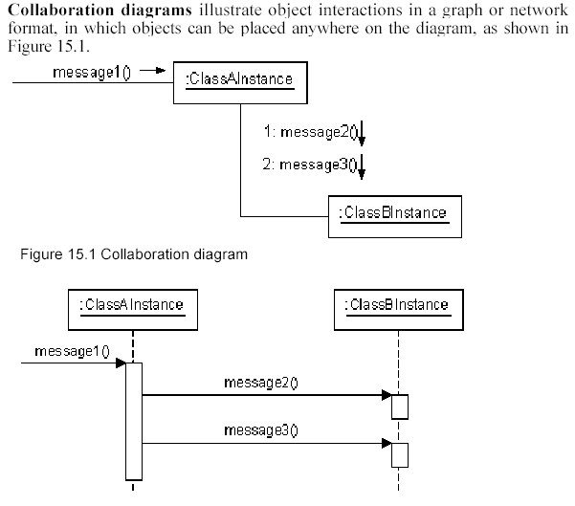
Interaction Diagram Notation

Slide 19
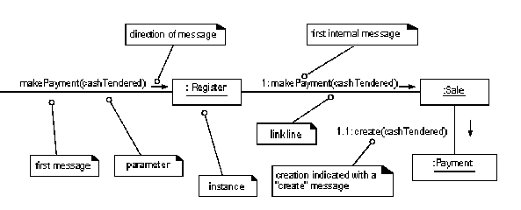
Example Collabration Diagram

Slide 20
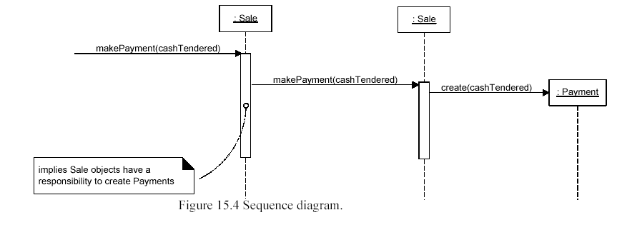
Example Sequence Diagram

Slide 21
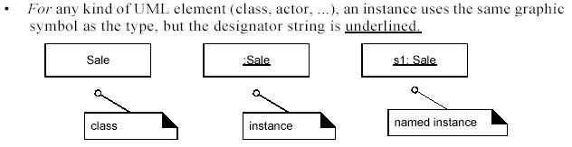
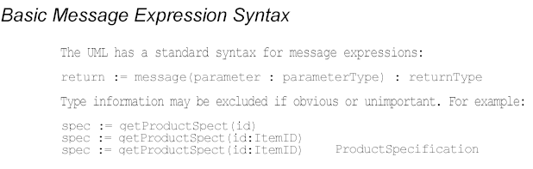
Common Interaction Diagram Notation

Slide 22
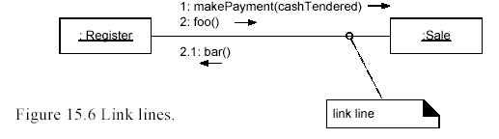
Basic Collaboration Diagram Notation
LINKS
A link is a connection path between two objects; it indicates some form of navi-
gation and visibility between the objects is possible (see Figure 15.6). More for-
mally, a link is an instance of an association. For example, there is a link.or path
of navigation.from a Register to a Sale, along which messages may flow, such as
the makePayment message.

Slide 23
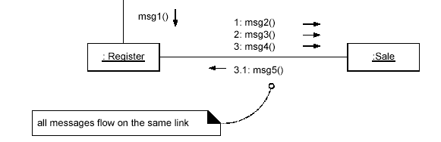
Basic Collaboration Diagram Notation...
MESSAGES
Each message between objects is represented with a message expression and
small arrow indicating the direction of the message. Many messages may flow
along this link. A sequence number is added to show the sequential
order of messages in the current thread of control.

Slide 24
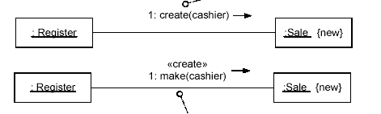
Basic Collaboration Diagram Notation...
CREATION OF INSTANCES
Any message can be used to create an instance, but there is a convention in the
UML to use a message named create for this purpose. If another (perhaps less
obvious) message name is used, the message may be annotated with a special
feature called a UML stereotype, like so: «create».

Slide 25
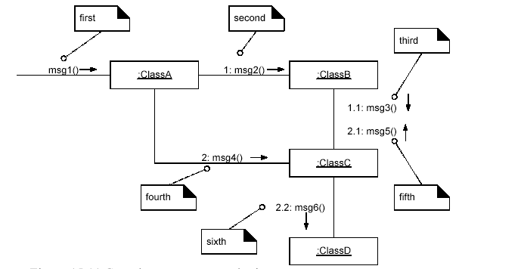
Basic Collaboration Diagram Notation...
The numbering scheme is:
1. The first message is not numbered. Thus,msg1() is unnumbered.
2. The order and nesting of subsequent messages is shown with a legal num
bering scheme in which nested messages have a number appended to them.
Nesting is denoted by prepending the incoming message number to the out
going message number.

Slide 26
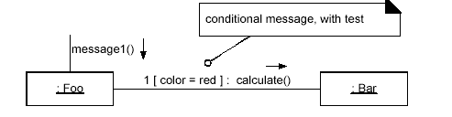
Basic Collaboration Diagram Notation...
Conditional Messages
A conditional message (Figure 15.12) is shown by following a sequence number
with a conditional clause in square brackets, similar to an iteration clause. The
message is only sent if the clause evaluates to true.

Slide 27
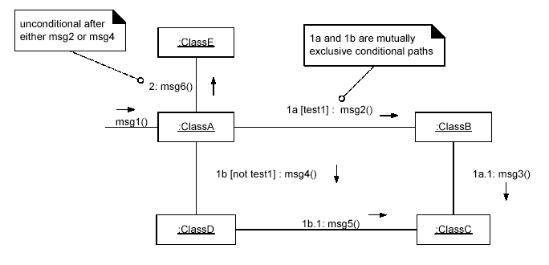
Basic Collaboration Diagram Notation...
Mutually Exclusive Conditional Paths

Slide 28
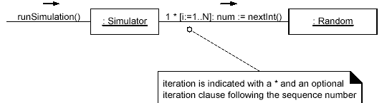
Basic Collaboration Diagram Notation...
Iteration or Looping

Slide 29
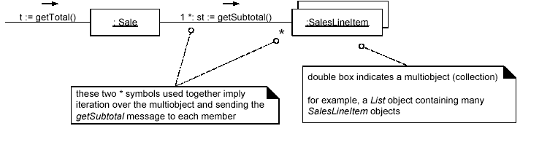
Basic Collaboration Diagram Notation...
Iteration Over a Collection

Slide 30
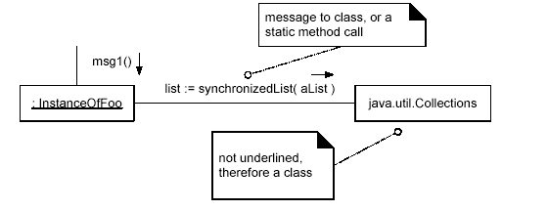
Basic Collaboration Diagram Notation...
Message to a Class Object

